Slide 1


Slide 2

What is “Together We’re Better?”
Inclusive Education Awareness Campaign
Began in 2004
Provides disability awareness as well as celebrates the principals of equity, unity, diversity, and inclusion
Students learn about disabilities
Awareness activities are designed to reduce barriers and reshape attitudes

Slide 3
Program Basics
Audience:
Started with Elementary & Middle School Age Children
Added Pre-K & High Schoolers
Four Components:
  Diversity Celebration Toolkit
  School Assemblies/Presentations
  Artwork & Drawing Contests
  Traveling Art Exhibit & Coloring Books in Public Venues Throughout Maryland

Slide 4
Goal of School Assemblies/Virtual Presentations
  Inclusion “buy-in” from entire school
  Working with complete grades (or an entire student body) for consistent messaging and follow up by parents and administration is most effective for broad impact and an enduring culture of a school or program
  Program design is aligned with school district goals for DEI, anti-bullying, restorative practices, and civility
  Tie-in to overarching school values: PALS program and Rocky the Racoon Mascot/Respect

Slide 5
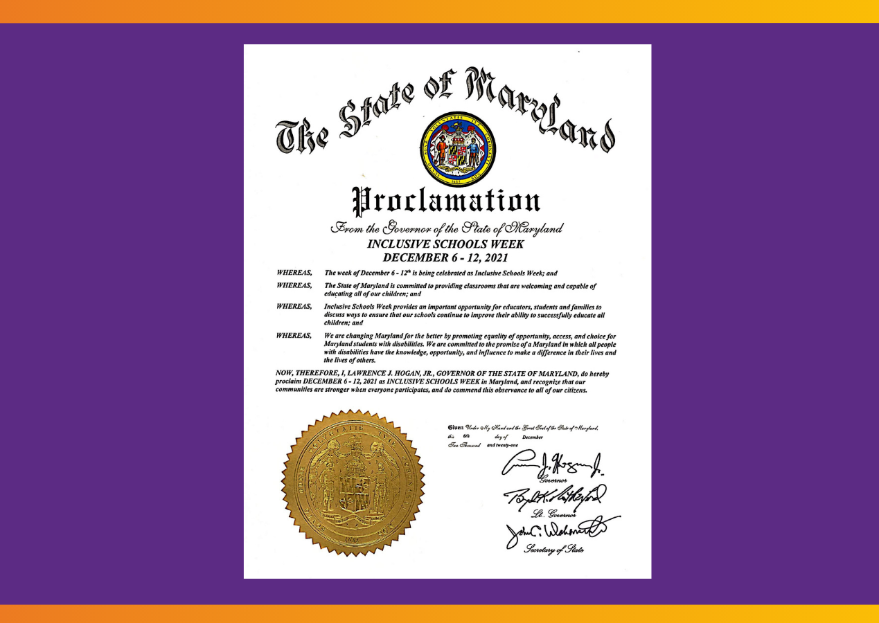
During National Inclusive Schools Week, Governor Larry Hogan issued a proclamation to Garrett Park Elementary School for celebrating Inclusive Schools Week.
The Proclamation was presented by Secretary Carol Beatty from the Maryland Department of Disabilities to the 5th graders at their TWB Assembly.

Slide 6
Presentation Elements Adapted for K - 5th Grade
My Disability – My Life
  Self-advocate facilitators, supported by The Arc Maryland staff, talk about their specific disability, discuss their own personal experiences, and provide tips on how to include people with disabilities both in and out of school
Short interactive games, activities, videos
Q & A
Giveaway (pencils, stress balls)
One-page, post-activity survey for students & teachers to measure impact-results shared with school

Slide 7
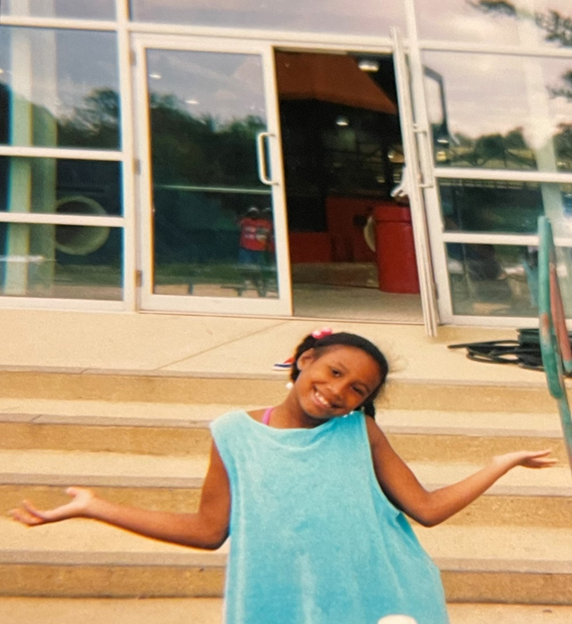
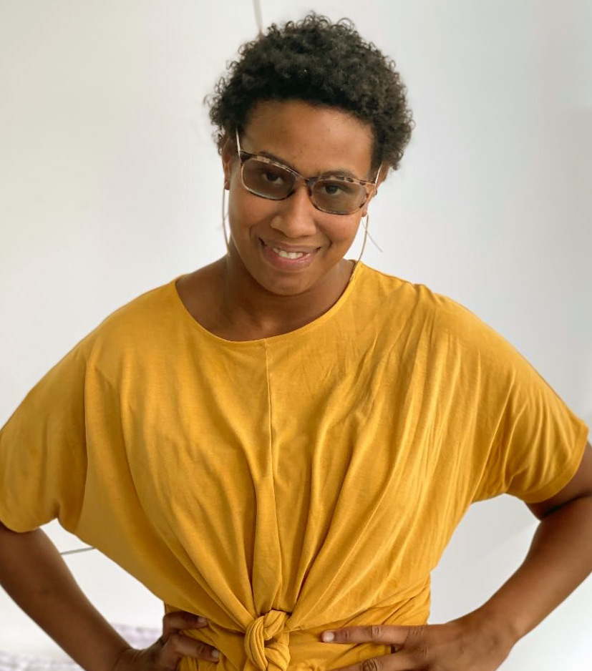
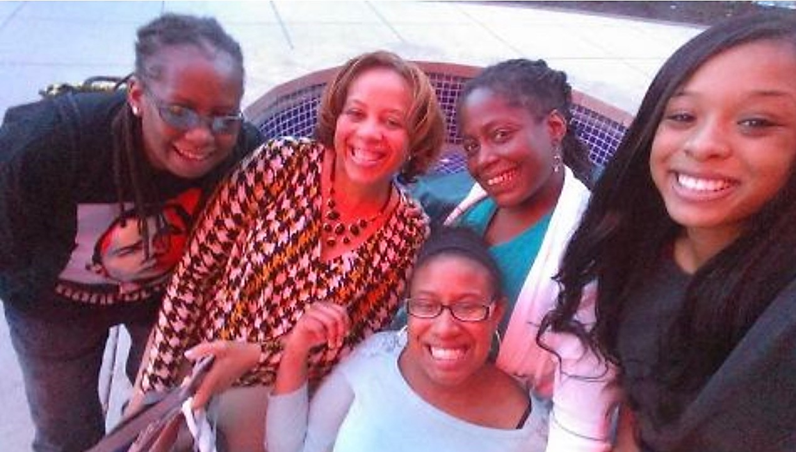
Dominique Palmer

Slide 8


Slide 9
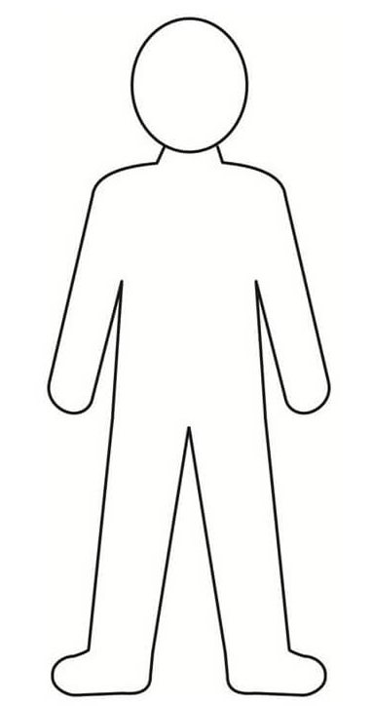
“Includer”
“Includer” Qualities
Word Bank:
1. If someone is upset, I can ask them if there is anything that I can do to help them.
Patient
Respectful
Caring
Curious
Kind
Trustworthy
Understanding
Friendly
Helpful
Polite
Civil
Courteous
Considerate
Generous
Welcoming
Understanding
Respectful
Friendly
2. I wait my turn and listen to people when they are talking, I try not to interrupt them.
3. I introduce myself to new people and ask them questions to get to know them better.

Slide 10
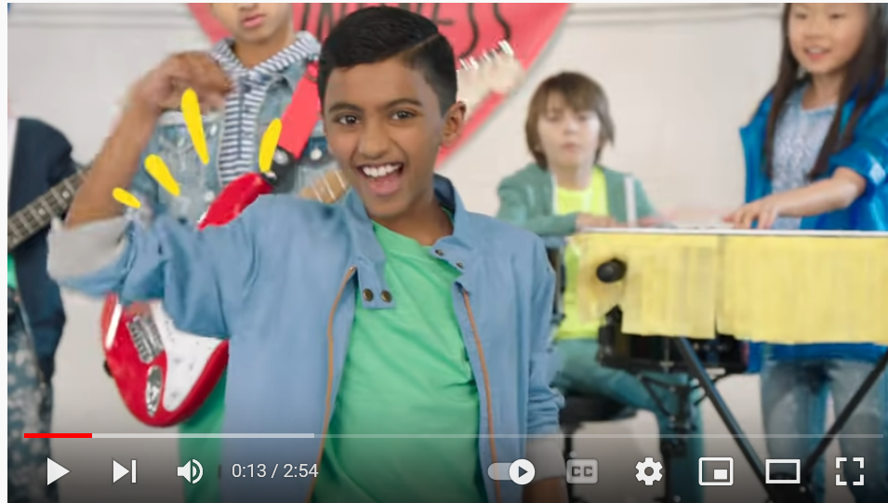
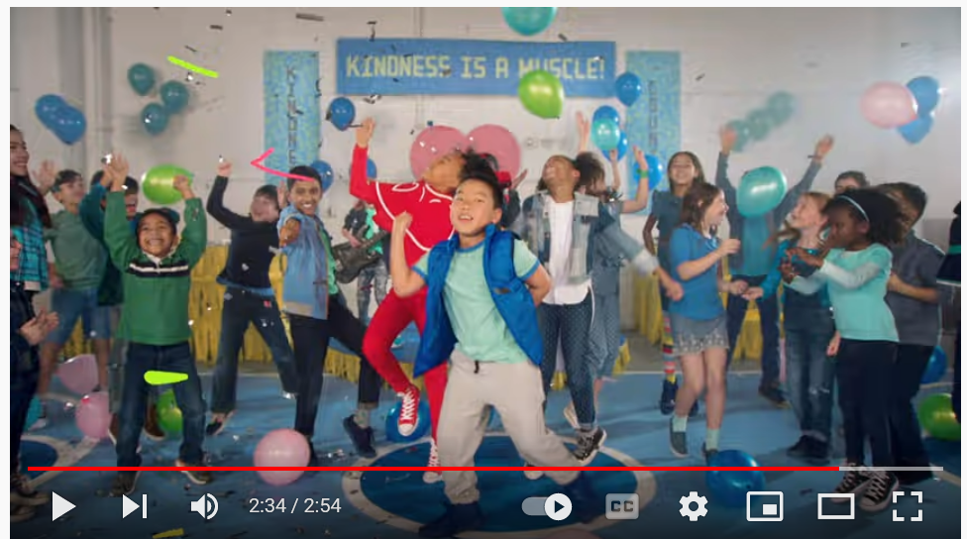
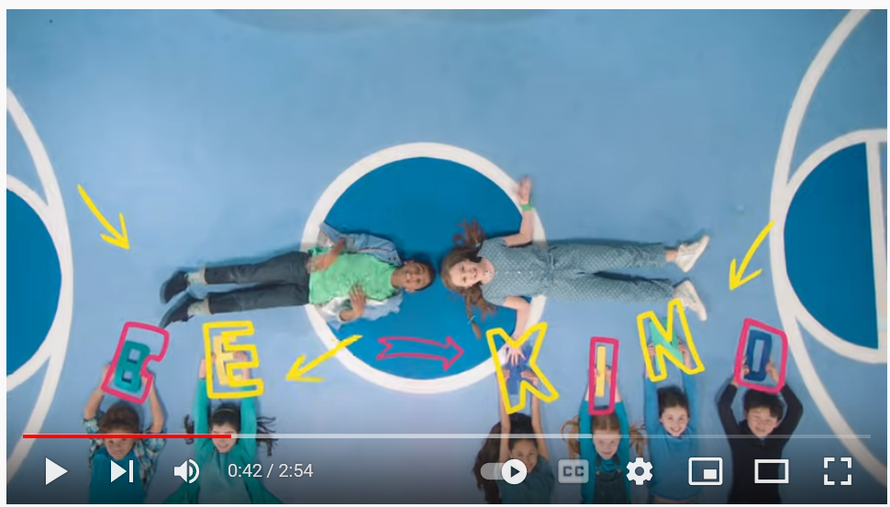
“Kindness is a Muscle”
Brain and movement break!

Slide 11
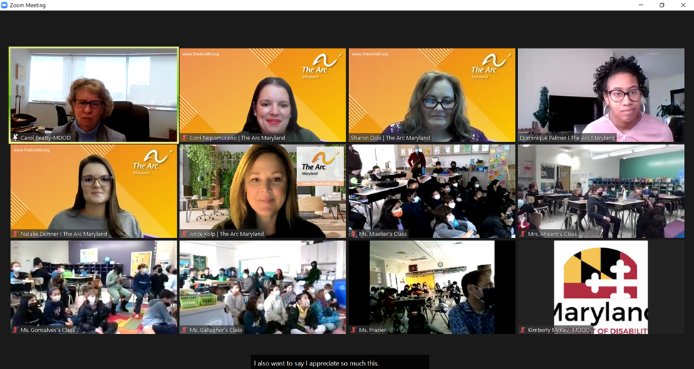
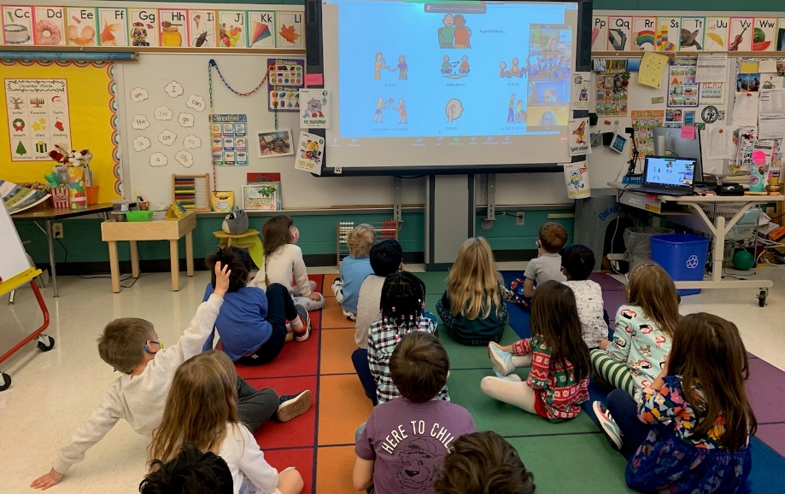
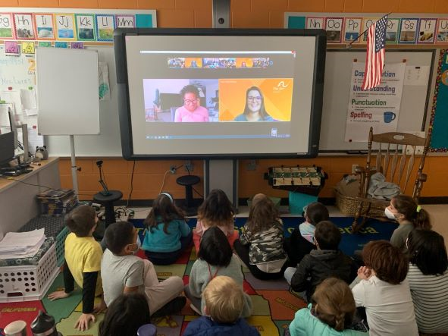
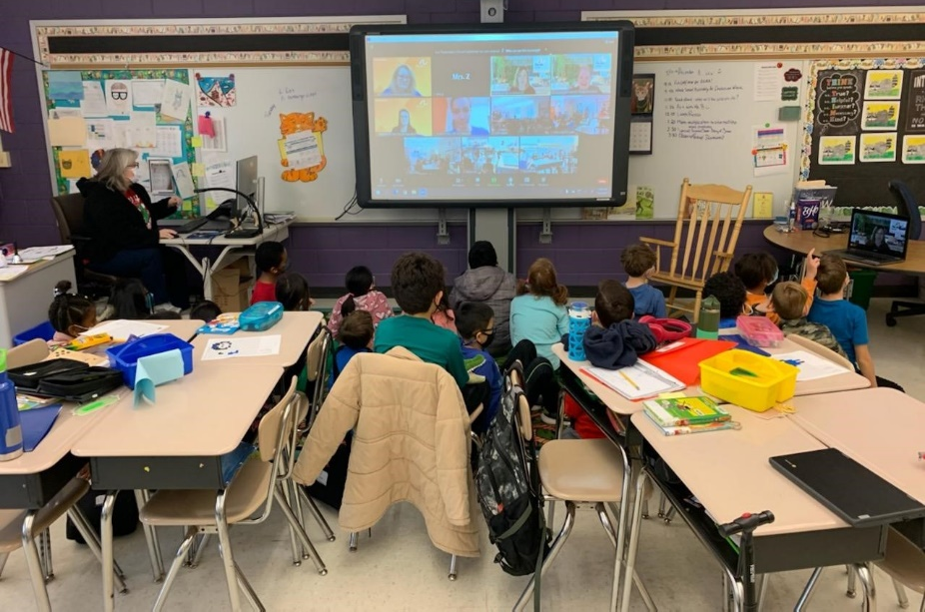
Garrett Park Elementary – TWB Assemblies in the Classrooms

Slide 12
Outcomes/Metrics
Virtual presentations reached roughly 680 students total at Garrett Park Elementary during National Inclusive Schools Week (December 6-10, 2021).
96% Enjoyed the presentation
98% Learned something new about people with disabilities
96% Agree that schools are better when all students are included
100% Agree that Kids with disabilities are “just like me” –
They want to play, learn, and make friends

Slide 13
Impact on Learning Community
Quotes from Garrett Park Administration and Faculty:
“One of the 5th grade teachers came up to me after the assembly and told me that 3 kids stood up and shared their disability with the class and what it means to them.”
“So much amazing feedback and very grateful for the opportunity.”
“Our principal turned to me during the 5th grade assembly and said “this is by far the best assembly we have ever had at Garrett Park.”
“Our room was so engaged – what a well-done presentation!”
“This message (of the presentation) is essential for everyone, especially children. It helps develop inclusive citizens and an inclusive society.”

Slide 14
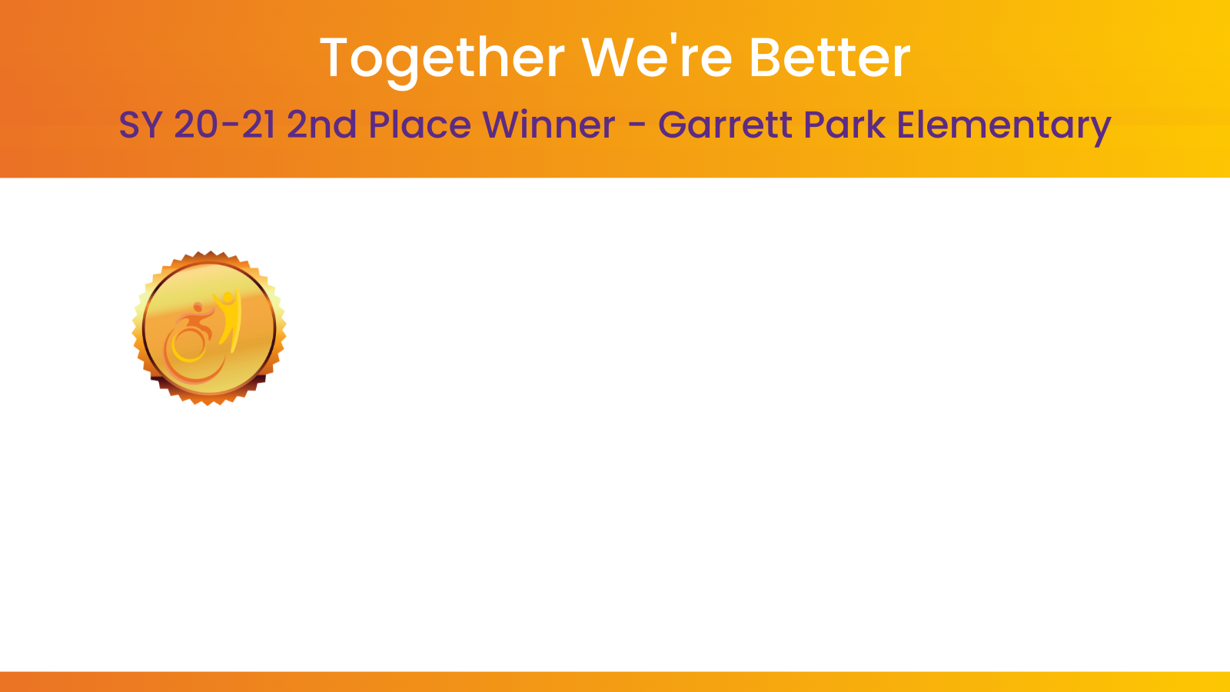
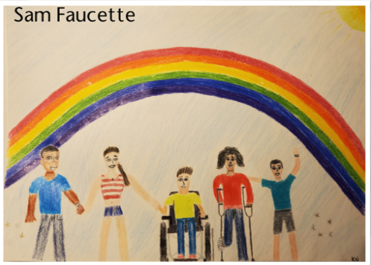

Slide 15
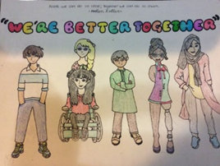
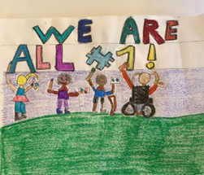
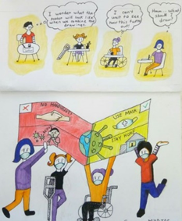
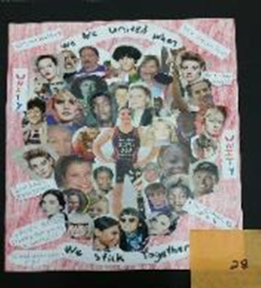
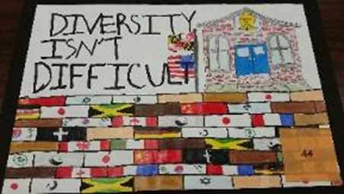
Past Artwork Contest Honorees

Slide 16



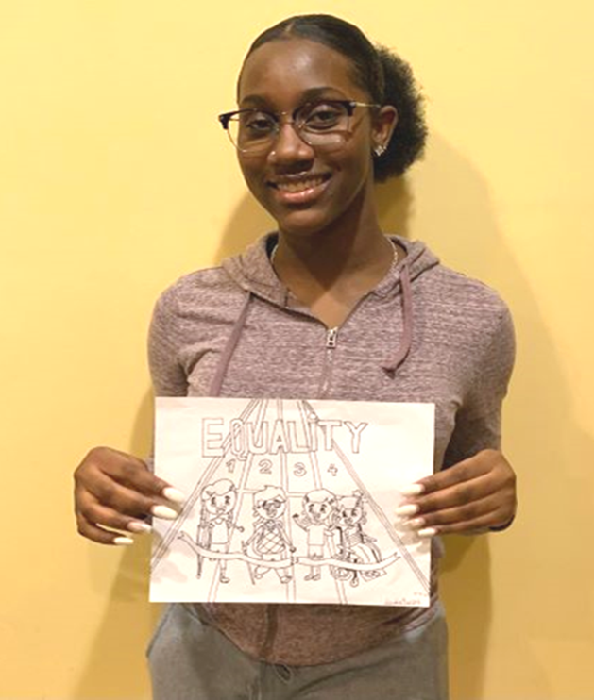

Slide 17
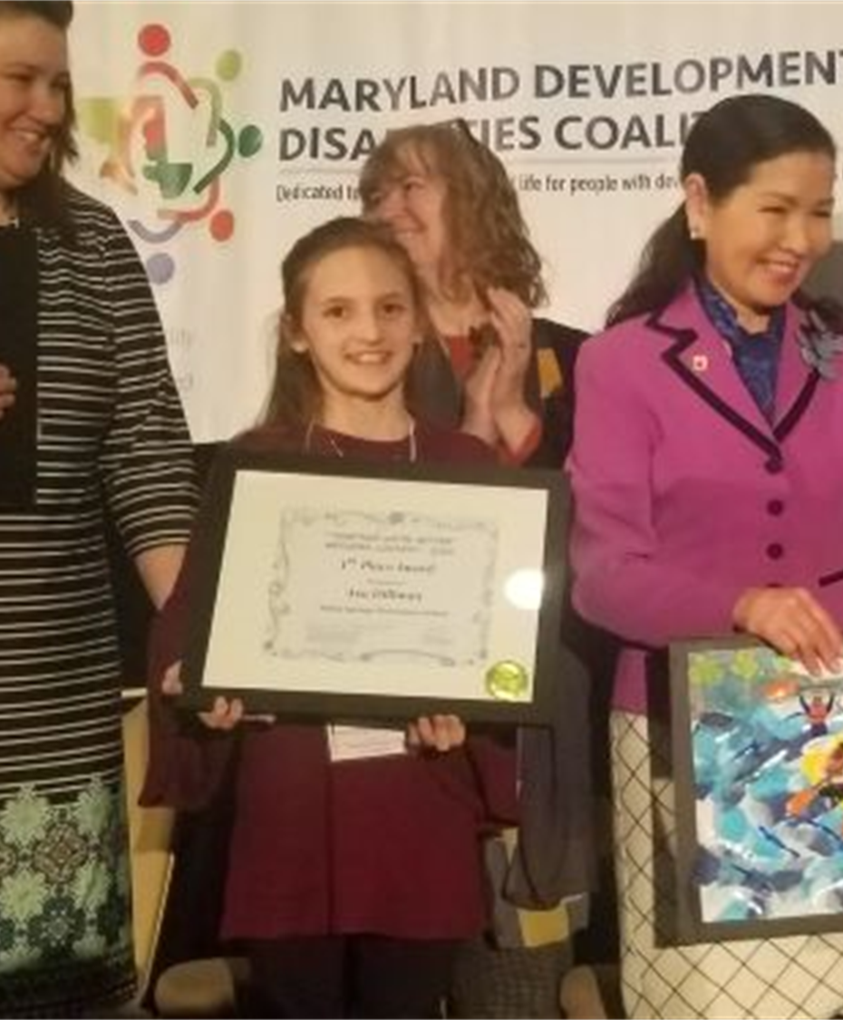
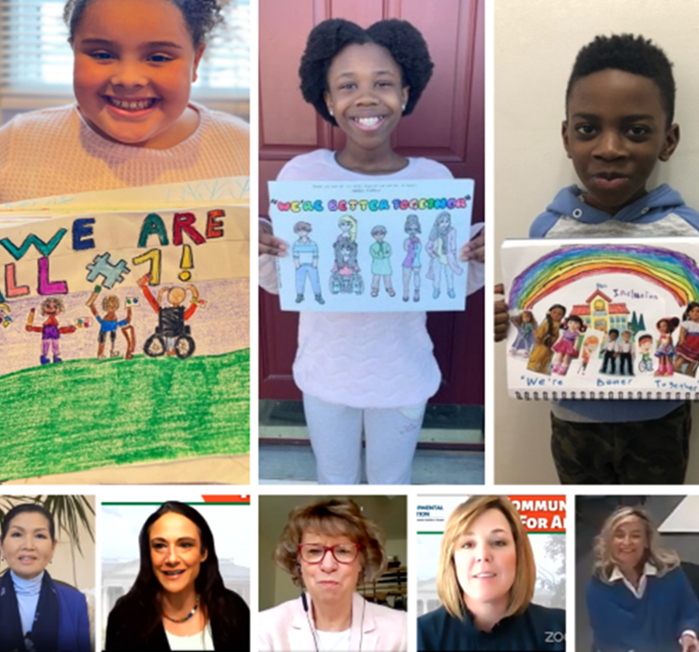
Artwork Contest Awards Celebration
Art Contest Submission Deadline –January 10th.
Honorees to be selected on January 20th. Students will win cash awards for their schools & visa gift cards for themselves.
All Awardees are invited to Developmental Disabilities Day at The Legislature on February 22nd in Annapolis (this year it is going to be a virtual awards celebration).
SY 20-21 Virtual Celebration
SY 19-20 In Person Celebration

Slide 18

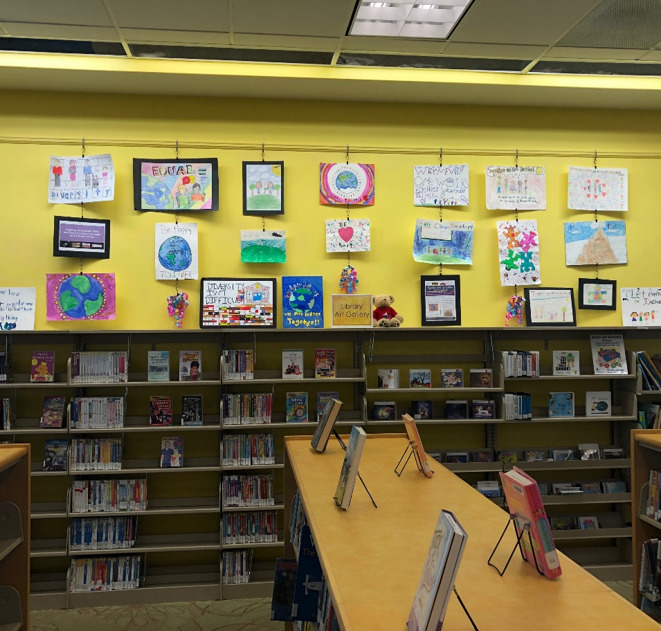
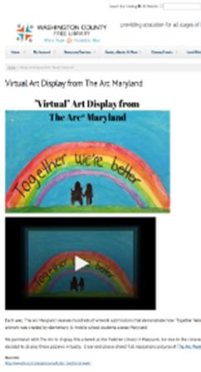
Traveling Art Display

Slide 19
Wishes and Dreams for the Future
Make inclusive education a reality for all children; creating a world where we all can learn, grow, and play together.
We look forward to returning to Garrett Park Elementary next year and hope to be in person!

Slide 20
